Slide 1


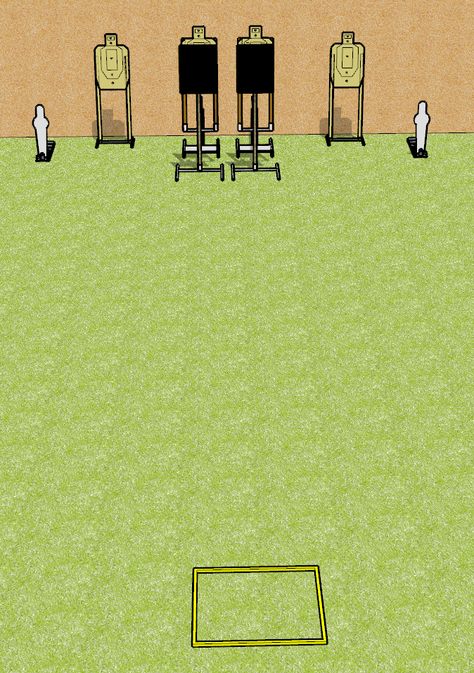
 | Dothan Gun Club – USPSA Match Bob It Course Designer : Drew Coleman
START POSITION : Standing in shooting box, facing uprange, wrists above shoulders. PCC facing downrange, stock on belt.
GUN READY CONDITION : Pistol loaded and holstered. PCC loaded, held with both hands, stock on belt, safety on. |  | SCORING: Comstock, 10 rounds TARGETS: 4 paper, 2 Steel SCORED HITS: Best 2 on paper, steel until down START-STOP: Audible, last shot RULES:
STAGE PROCEDURE: On start signal, engage either the static paper or the steel, perform a mandatory reload, then engage the remaining array. The bobbers may be engaged at any time. The bobbers are not disappearing.

Slide 2
Bob It
Written Stage Briefing
Bob It is a 10 round, 50 point, Comstock speed shoot. There are four USPSA targets and two mini poppers. The best two hits on paper will score, and steel must fall to score. The start signal is audible.
The bobbers are activated by the poppers closest to them. Please check the activators prior to walkthrough and set them the same way for each shooter.
Handgun start position is standing in shooting box facing uprange, wrists above shoulders. Handgun is loaded and holstered.
PCC start position is standing in shooting box facing downrange. Loaded carbine is held with both hands, stock on belt, safety on.
On start signal, engage either the static paper or the steel, perform a mandatory reload, then engage the remaining array. The bobbers may be engaged at any time. The bobbers are not disappearing.

